Slide 1

IDK App
Alex Rush

Slide 2
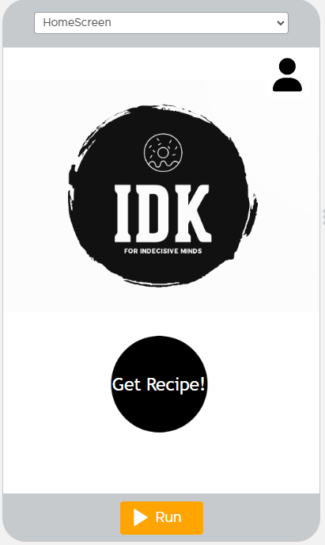
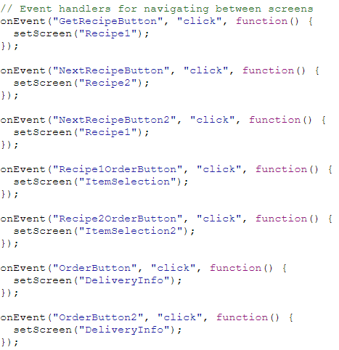
We start out with the home screen of the IDK app.
The main workhorse of the entire app is the onEvent click function which allows the user to move from each screen.
This screen is just the opening page as you would see on any standard app with the option.
We have buttons for recipe selection and profile selection which holds recipe favorites.

Slide 3
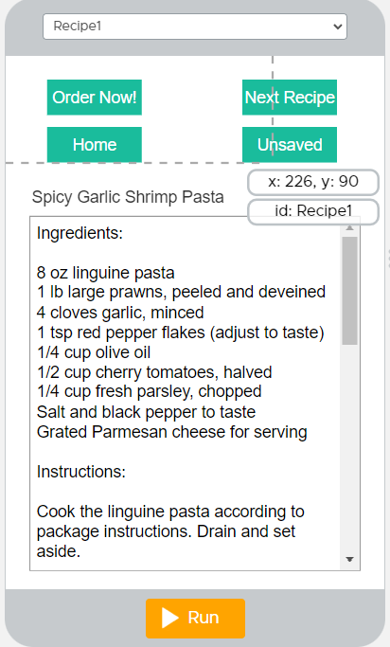
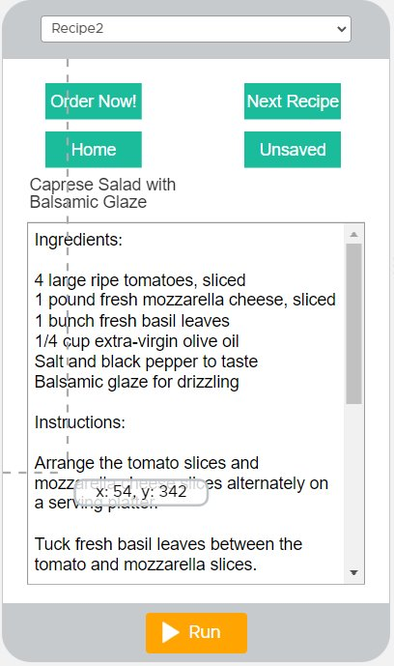
The recipe screens are mostly the same with a return home button and recipe save feature which unhides a button in the profile menu to view these recipe pages.

Slide 4
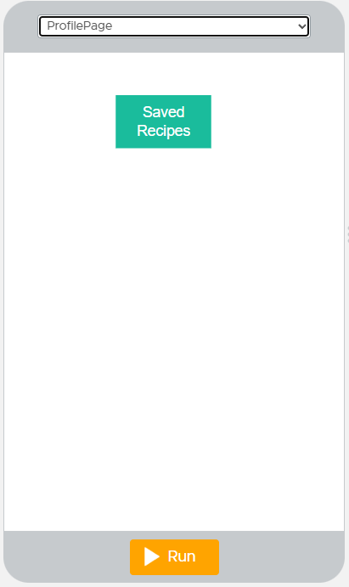
Just a onEvent click link to saved recipes there was space left if I thought to add other functionality.

Slide 5
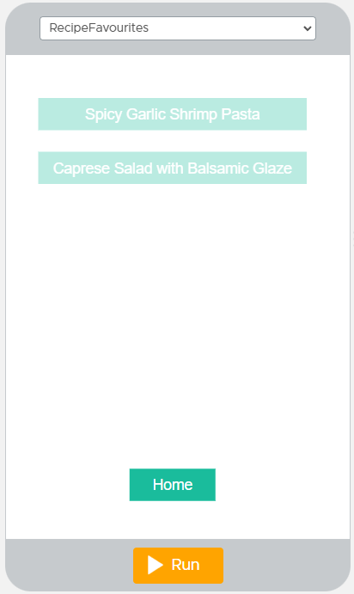
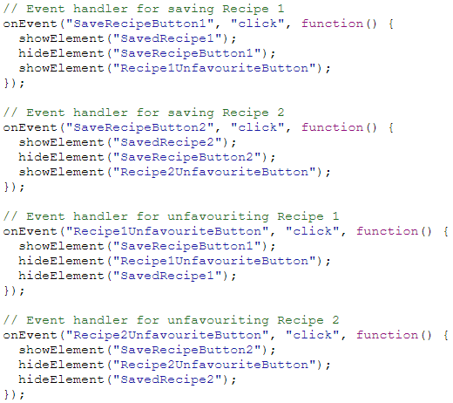
This screen hides and unhides the recipes depending on if the recipes have been saved on the recipe selection screens.
Allowing you to navigate to the specific recipe for instance if there were more added.

Slide 6
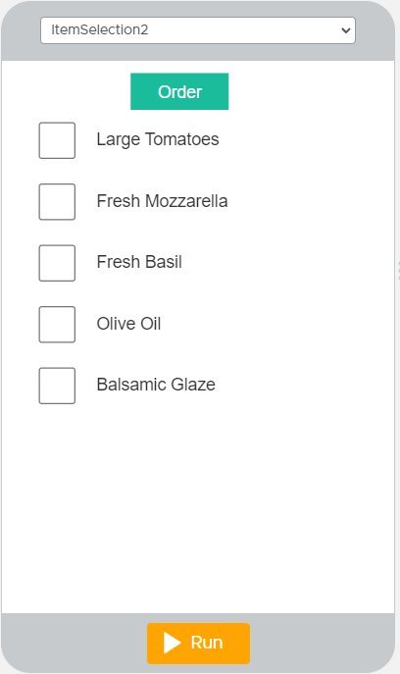
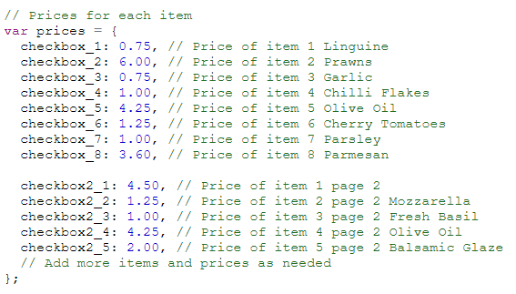
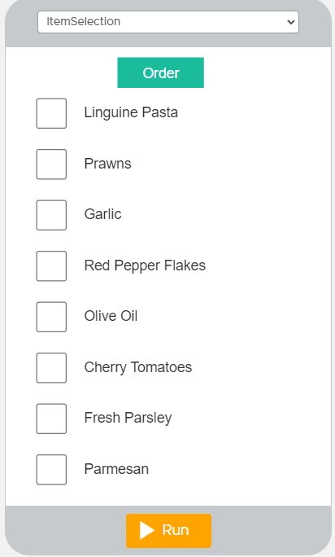
The item selection screen allows you to pick the selected ingredients that you wish to order. Each checkbox is checked on the order button being clicked for its value which is then totaled on the payment screen.
To stop people navigating onto both pages the order now button sets the value to 0 and unchecks the boxes.

Slide 7
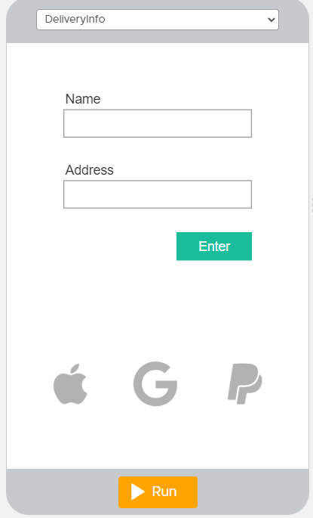
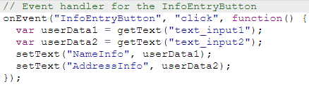
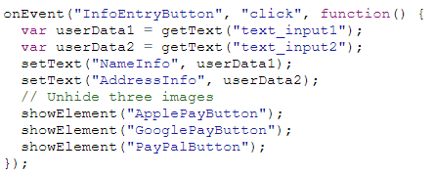
From the item selection screens you are taken to the payment method screen which is entirely just for show. But the name and address fields are used later via getText to display the correct delivery information along with the cost of the order.
Entering the information into the field and pressing enter unhides the payment options.

Slide 8
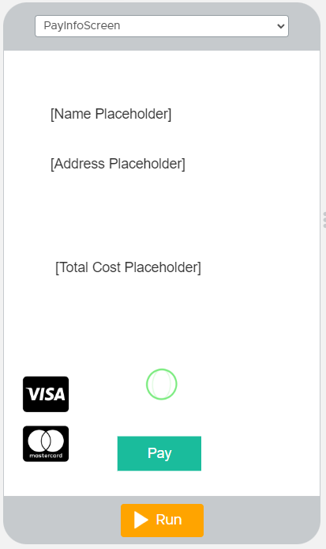
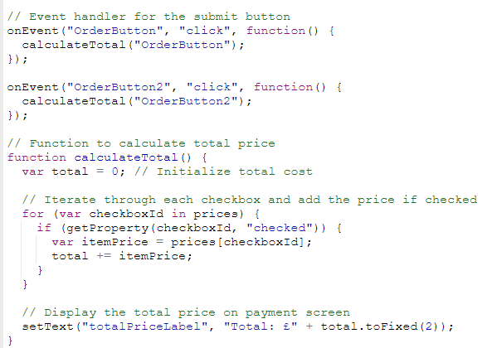
This is where the getText and item totals are brought together and displayed for the customer to verify with a gif of the usual pay verification on Apple in absence of an actual pay system.

Slide 9
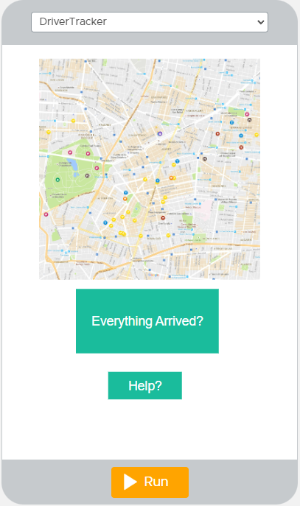
This is simply an image of google maps with a button to navigate to a help screen if the "order" hasn't arrived.
And a button to navigate back to the home screen so you can review the recipe.

Slide 10
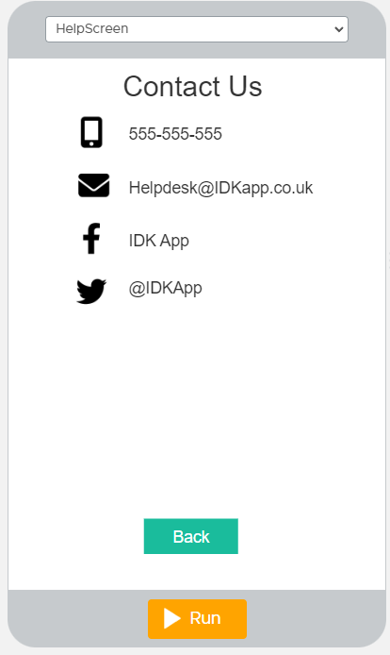
All the contact info someone could possibly need to contact the company about something going wrong with their order.

